Slide 1
SMA &
HULL TRADING
Week 1 presentation

Slide 2
Introduction
Data Cleaning
2. Data Insight
3. Data Selection
4. Experiments...

Slide 3
Data Cleaning
Data Matching
Bad Data Searching
Dataframe Construction

Slide 4
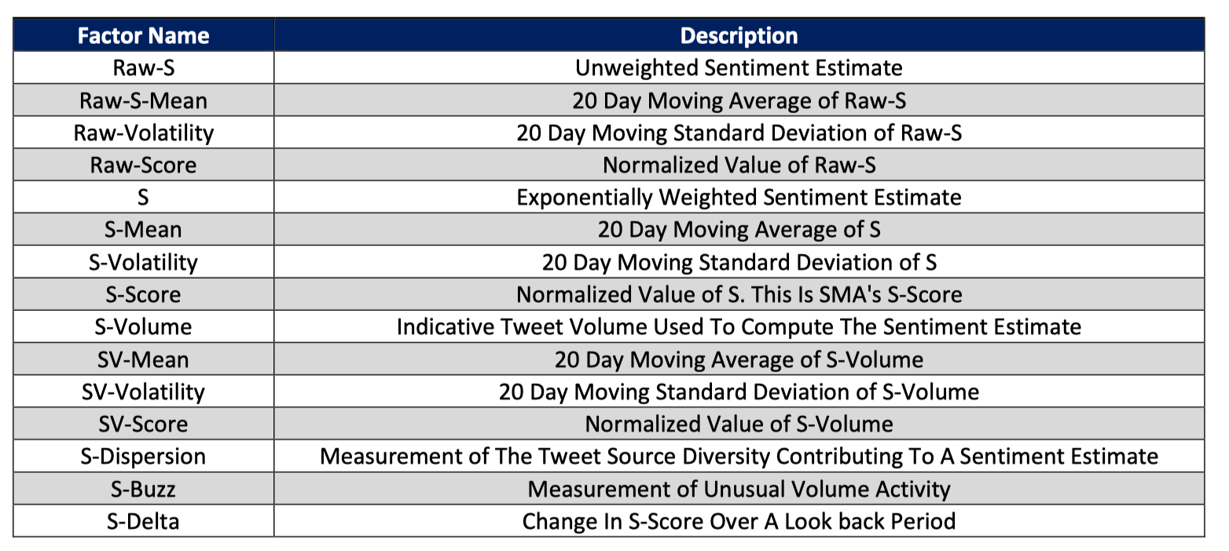
Data Insight

Slide 5
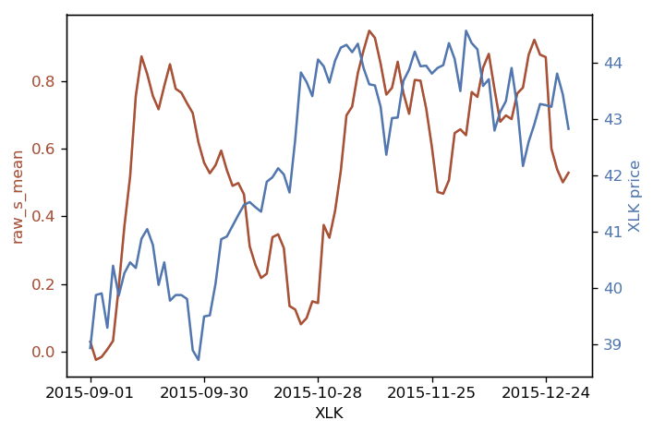
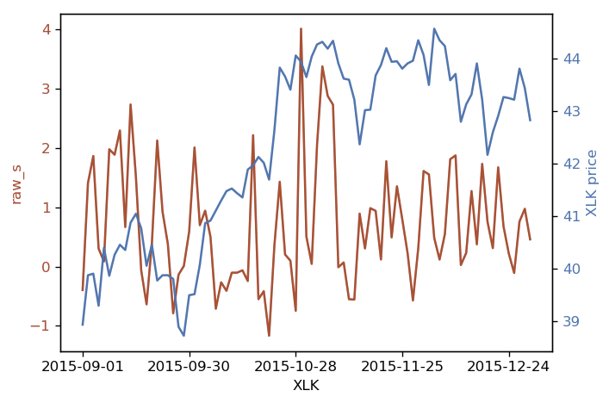
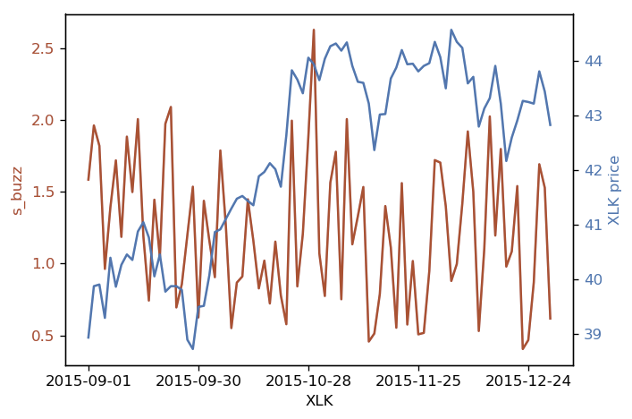
Data Insight

Slide 6
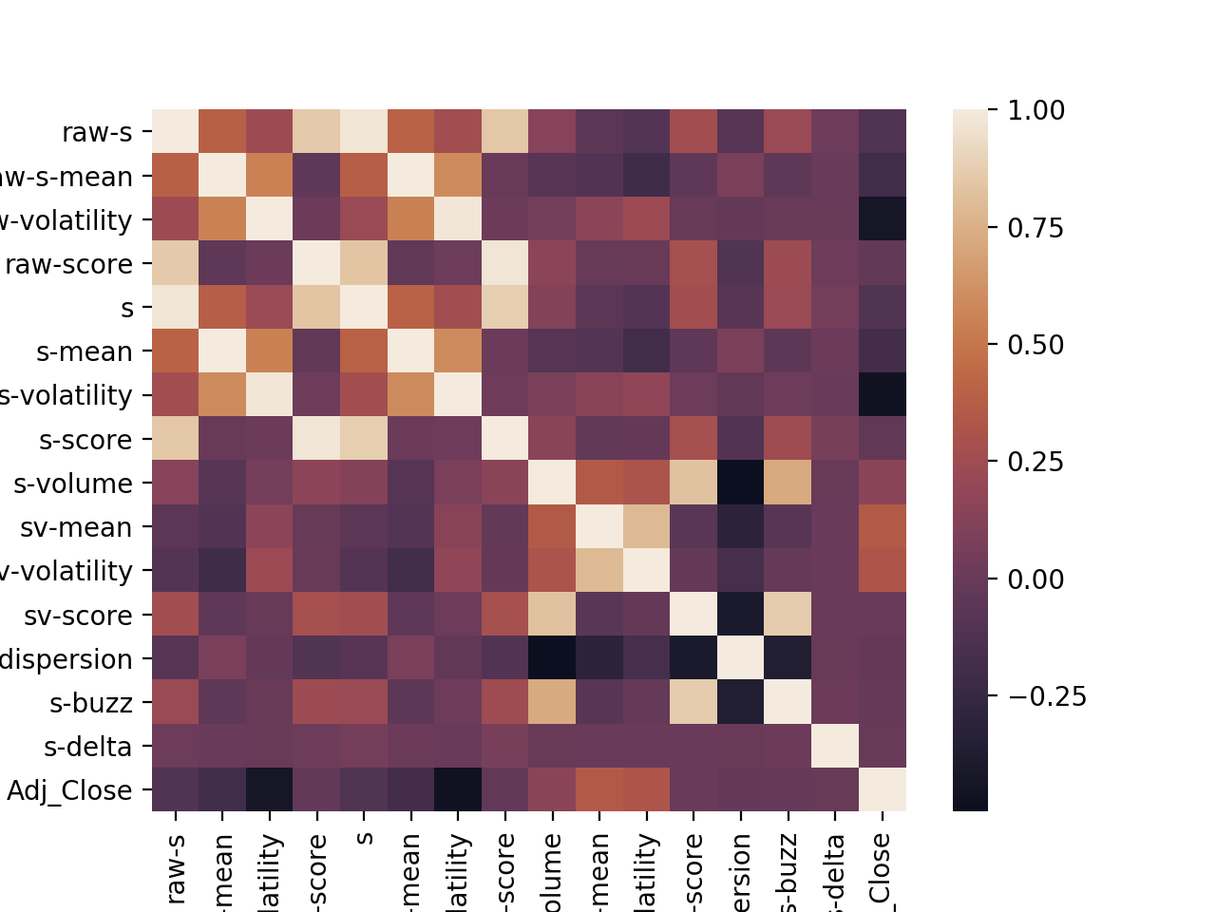

Slide 7
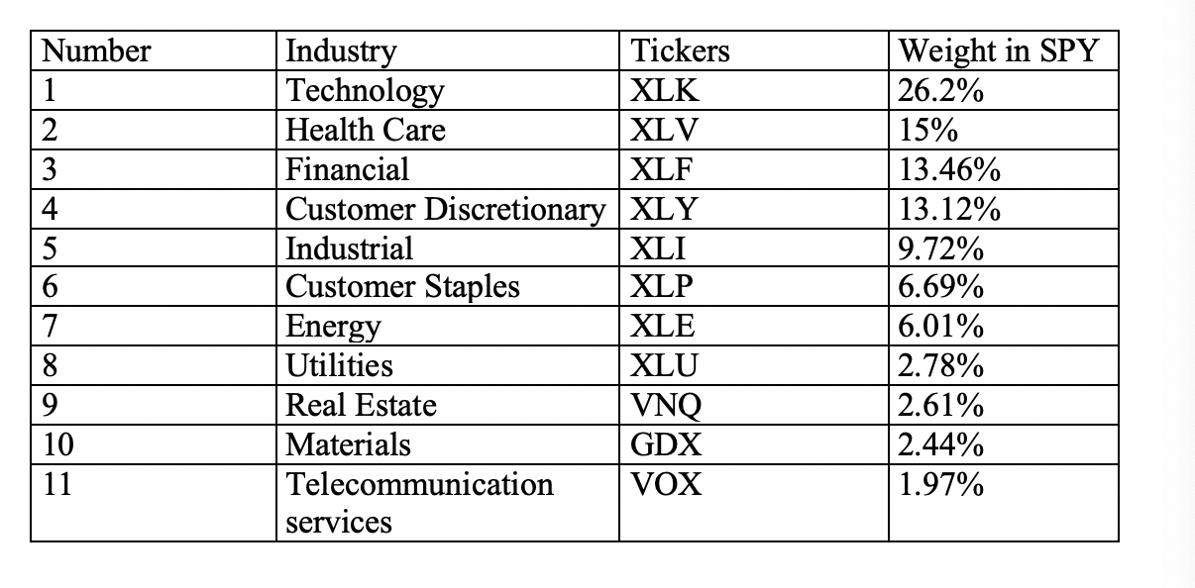
Data Selection

Slide 8
Some Experiments...
Objective:
Prices
Returns
Strategy:
Regression
Classification
Time Series:
Forecast
Intraday data:
mean
other method

Slide 9
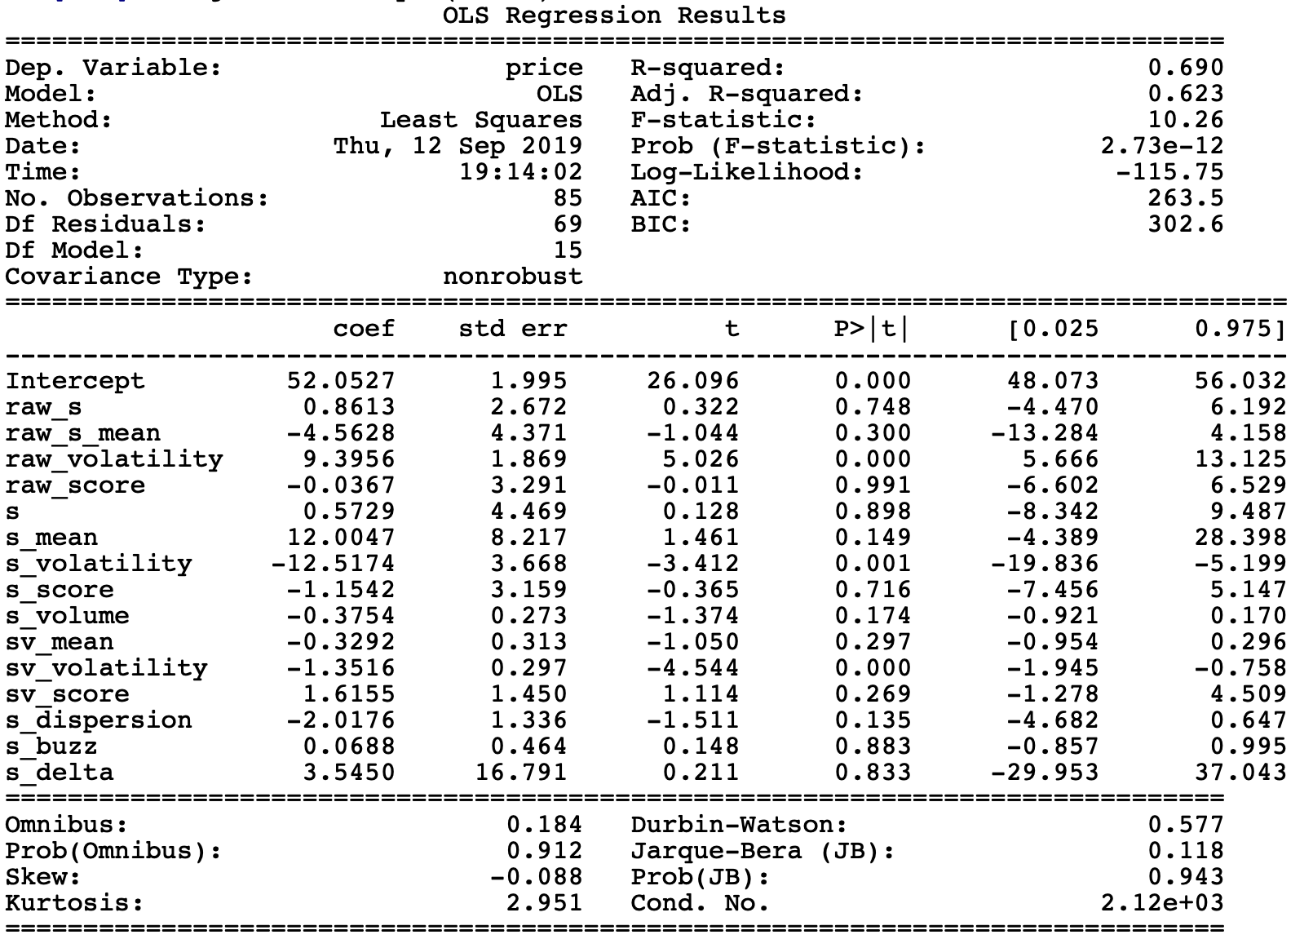
Significance Tests

Slide 10
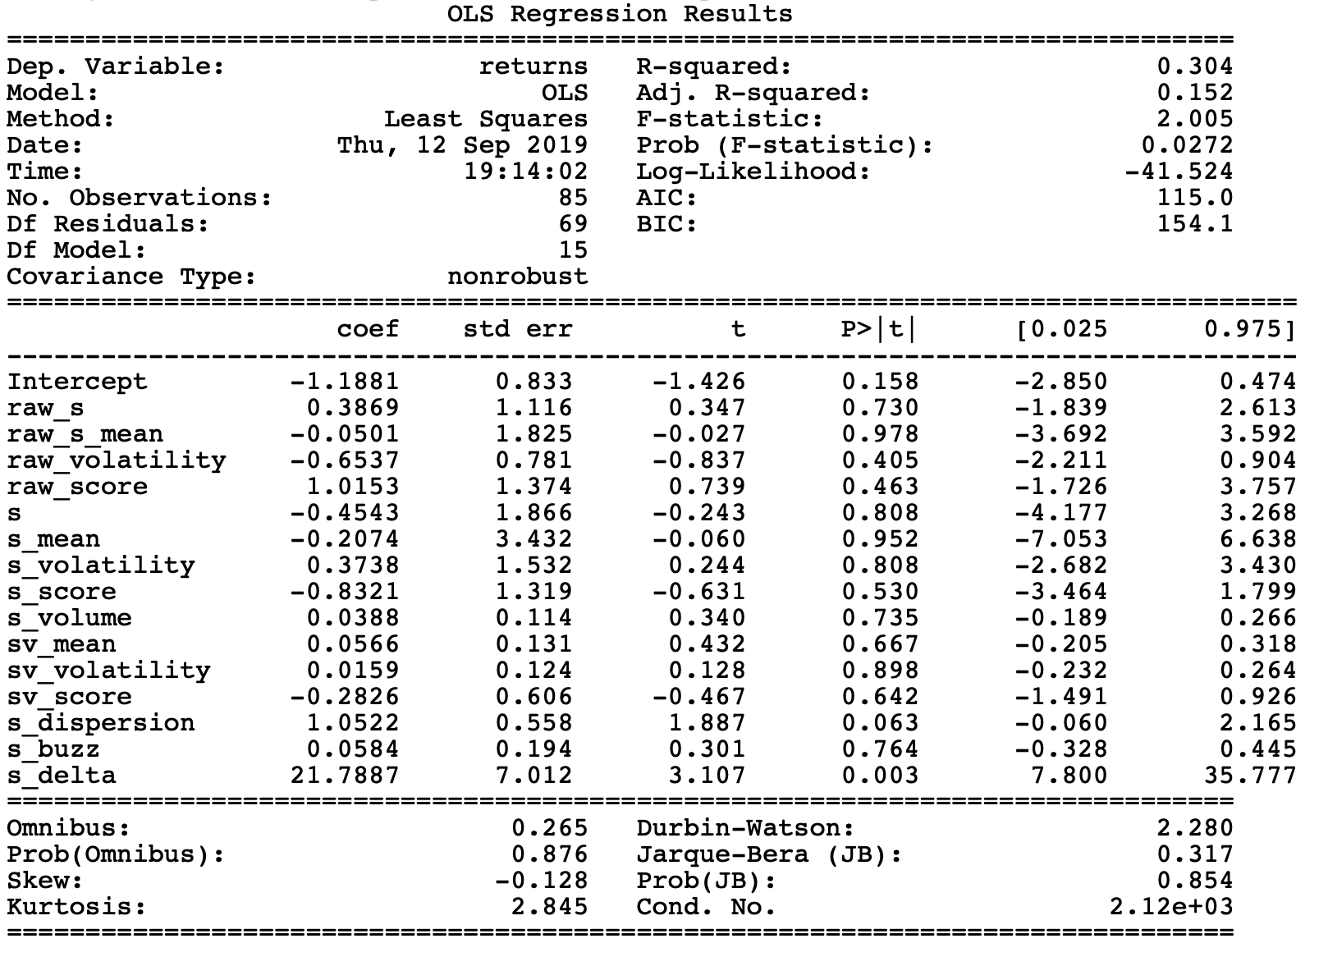
Significance Tests

Slide 11
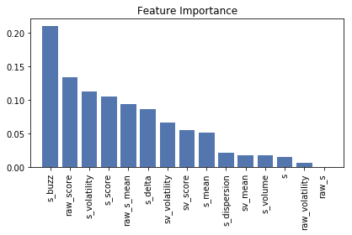
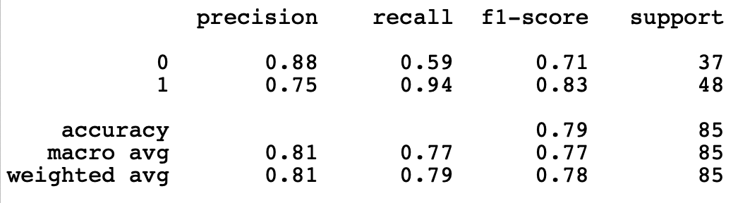
Classification

Slide 12
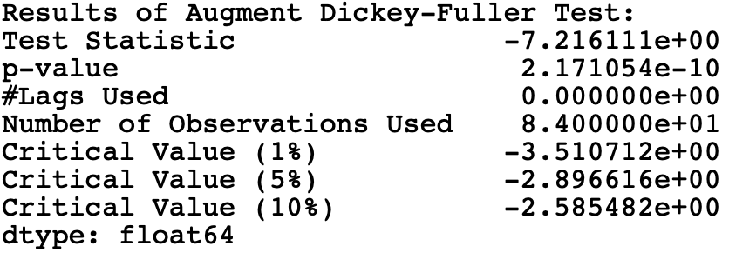
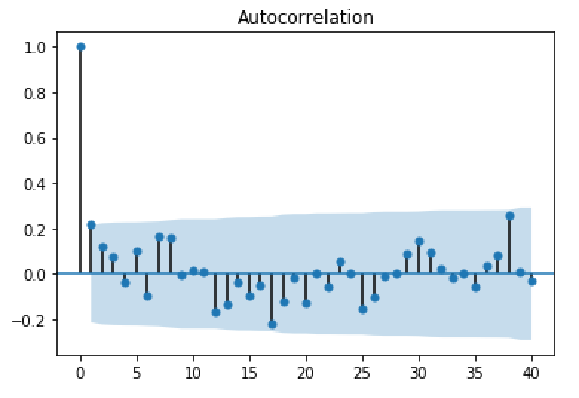
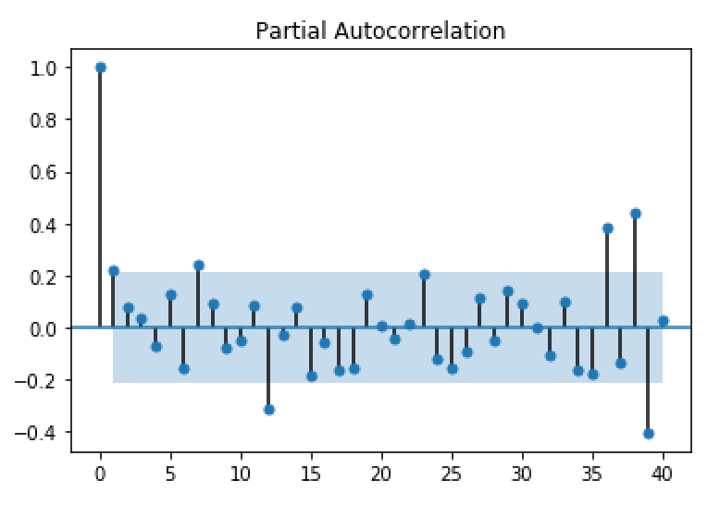
Stability and Autocorrelation

Slide 13
Conclusion
Prices is highly related to the volatility.
Most of classification model has a accuracy score that is cool.
For Time-Series Forecasting, It is better to use ARMA(p,q) model.

